Slide 1
Lab 3
Spectral Analysis and Filtering

Slide 2
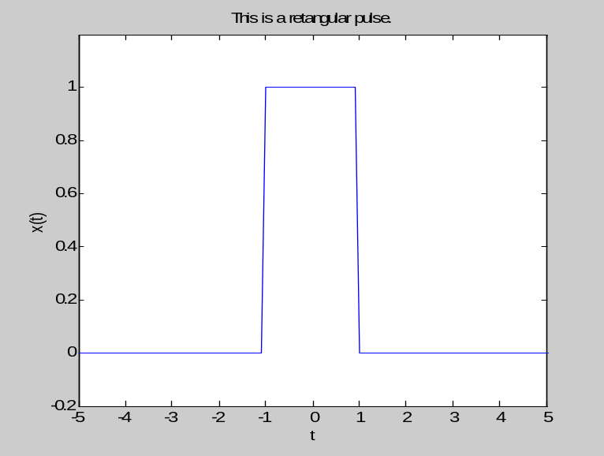
1 Rectangular pulse
1.1 Plot time-domain signal
tarray=-10:0.1:10;
T=2; %脉冲宽度
S=rectpuls(tarray,T);
plot(tarray,S);
axis([-10 10 -0.2 1.2]); %定义坐标显示的范围
title('This is a retangular pulse.');
xlabel('t');
ylabel('x(t)');
axis([-5 5 -0.2 1.2]);
axis([-5 5 -0.2 2]);

Slide 3
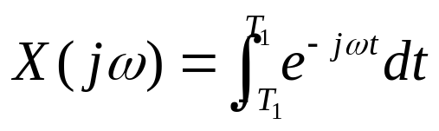
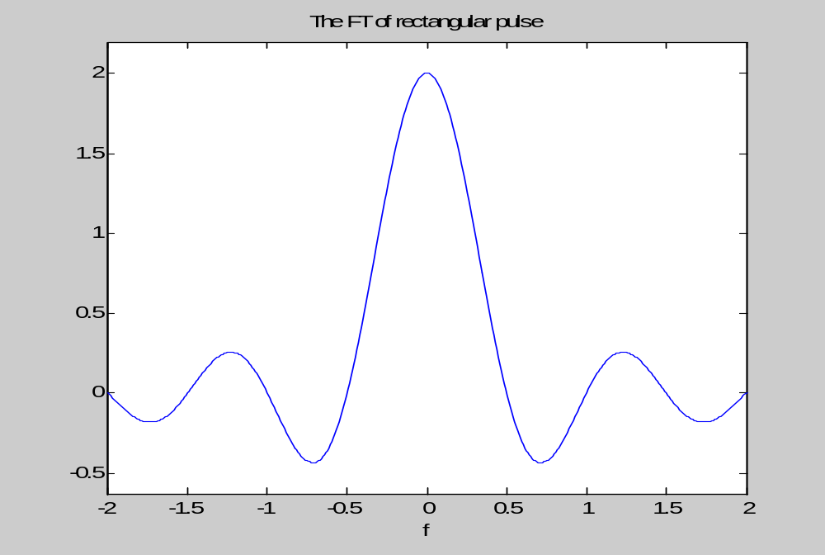
1.2 Fourier transform
syms t f; %定义变量t和f
F=int(exp(-j*2*pi*f*t), t, -T/2, T/2); %integral
ezplot(F,-2,2); %plot function
title('The FT of rectangular pulse');

Slide 4
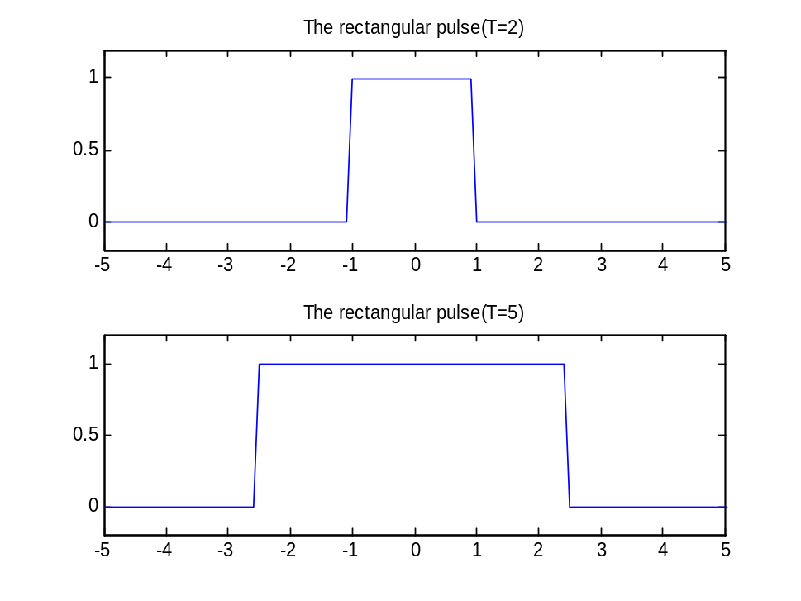
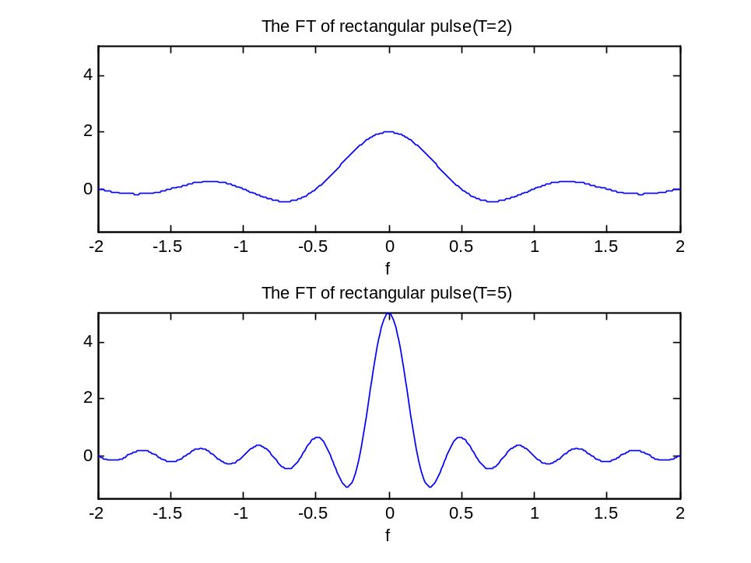
脉冲宽度变化时，频谱的改变
T=2 T=5

Slide 5



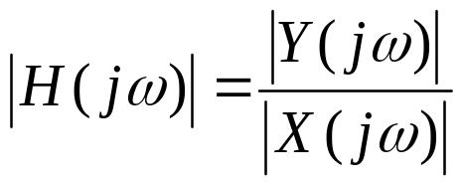
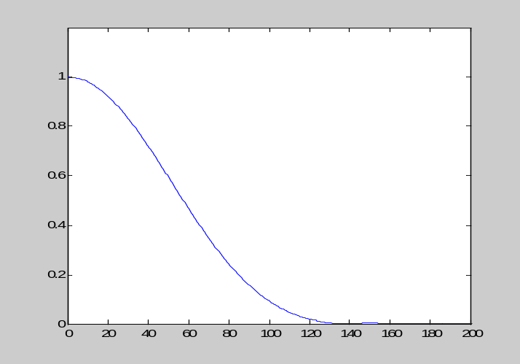
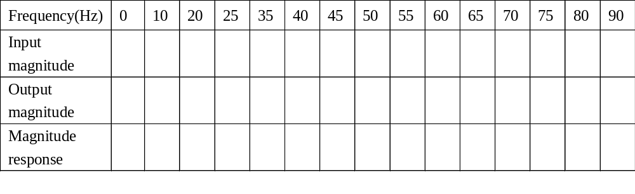
2. Frequency response of the system
正弦测量技术
x(t)
LPF
y(t)

Slide 6
fs=1000; %采样频率
t=0:1/fs:2;
f=2; %输入cos信号的频率
x=cos(2*pi*f*t); %输入的单频信号
plot(t,x);
axis([0 1 -1.2 1.2])
fc=50; %滤波器的截止频率
N=20; %滤波器的阶数
[b]=filter_sys(N,fc,0); %低通滤波器
y=filter(b,1,x); %滤波
plot(y)

Slide 7
>>freq_response
the sampling frequency Hz:1000
the frequency of input signal Hz:20
the order of the filter:20
select the filter type:0---low pass1---high pass:2---bandpass3---stoppass:0
the cutoff frequency of the filter Hz:50
the maximum amplitude of the input signal: 1
the maximum amplitude of the output signal: 0.9223
g= 0.9223

Slide 8
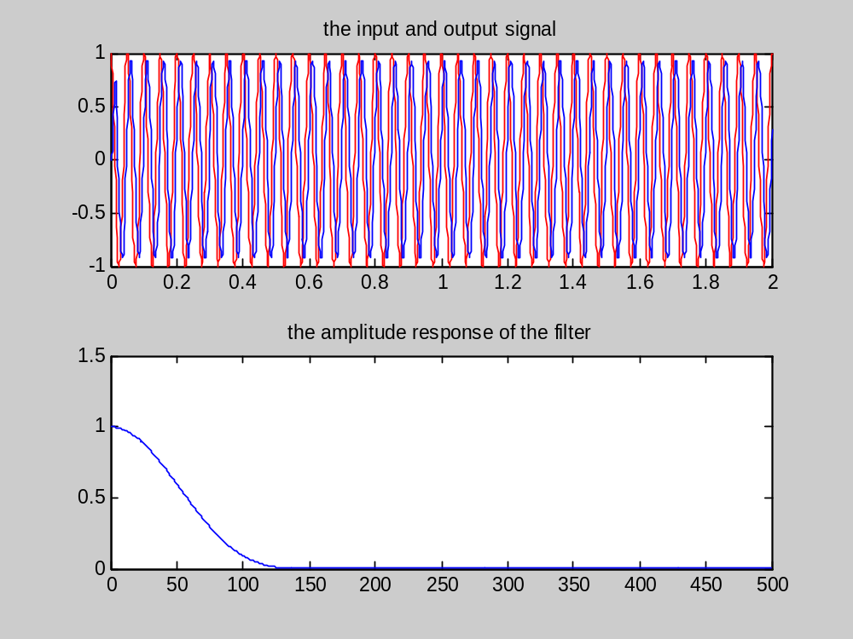
the frequency of input signal Hz:20
g=0.9223

Slide 9
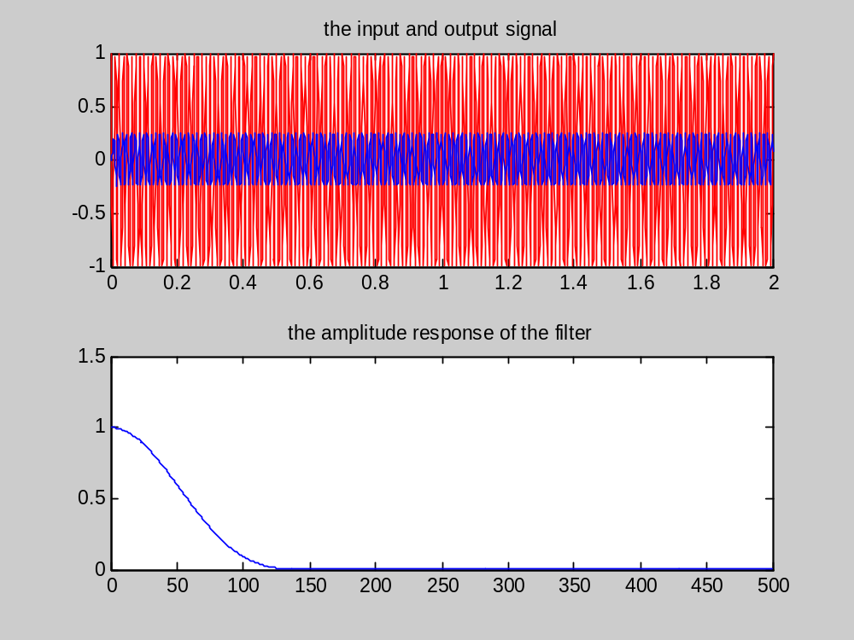
the frequency of input sinal Hz:80
g=0.2433

Slide 10
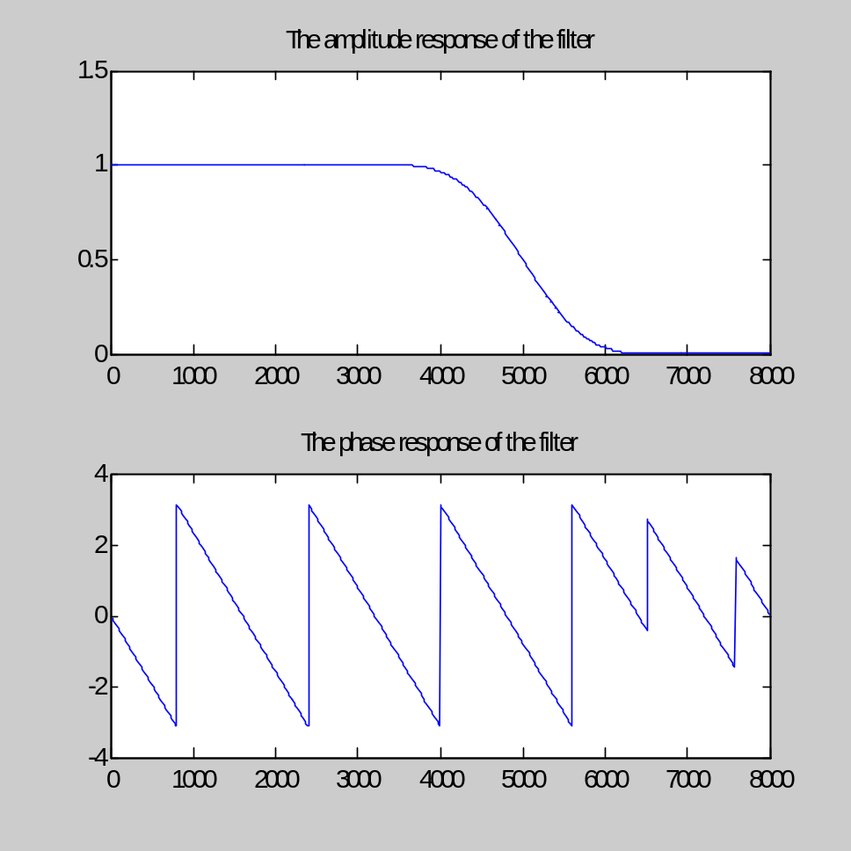
3.Filtering and its application
3.1 Filter
fs=16000;
fc=5000;
wc=2*fc/fs;
b=fir1(20,wc,’low’);
[H,w]=freqz(b,1,2^10,fs);
subplot(2,1,1);
plot(w,abs(H));
subplot(2,1,2);
plot(w,angle(H));

Slide 11
3.2 Filtering of speech
>>[S_in, S_out]=E3_speech_Filt();
the order of the filter:20
select the filter type:0---low pass1---high pass:2---bandpass3---stoppass:0
the cutoff frequency of the filter Hz:5000
>> sound(S_in,16000);
>> sound(S_out,16000);

Slide 12
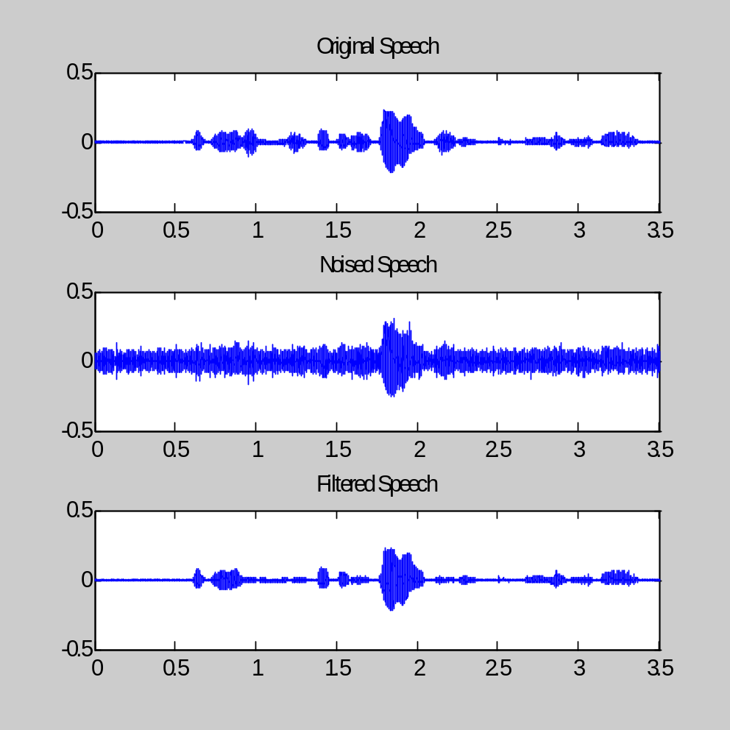
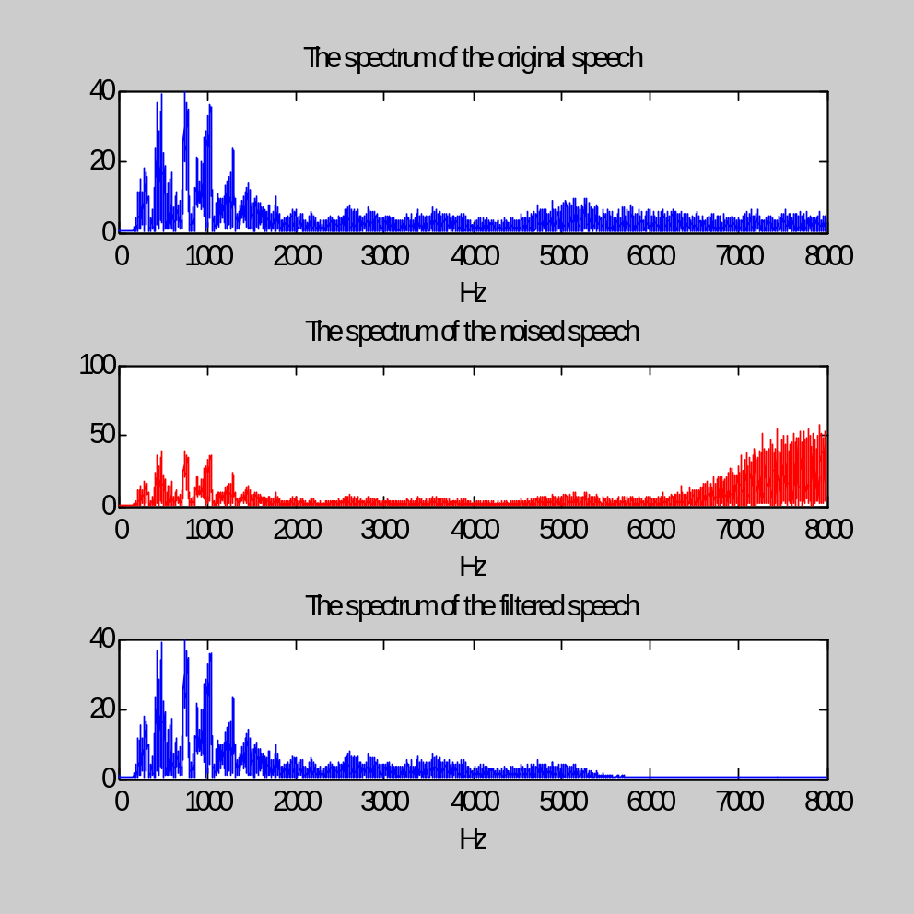
Spectrum comparison

Slide 13
3.3 Filtering of Image
E3_image.m
inp2=imread('Lena.tif');
myfilter=fir1(20,0.4,'high');
myfilter2=ftrans2(myfilter);
outp2=imfilter(inp2,myfilter2);
imshow(inp2);

Slide 14
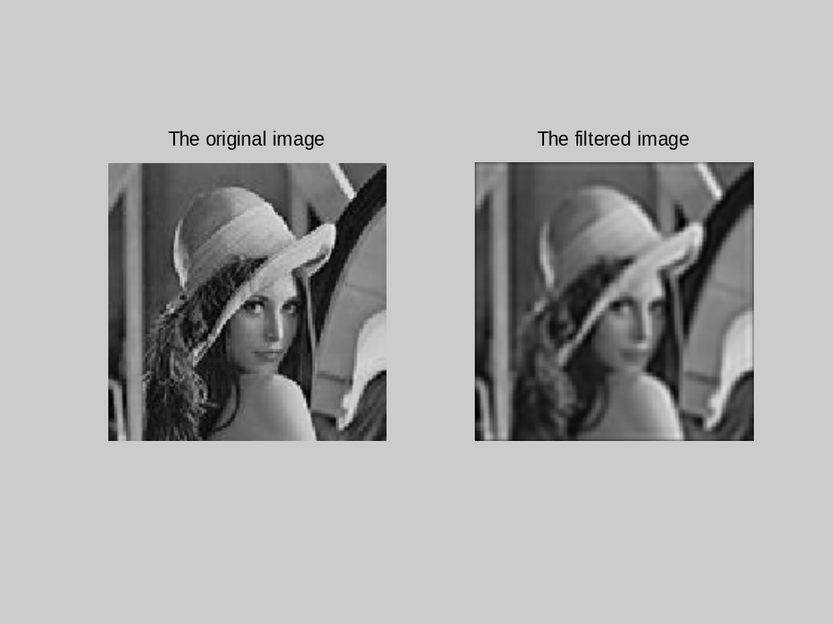
Lowpass filter

Slide 15
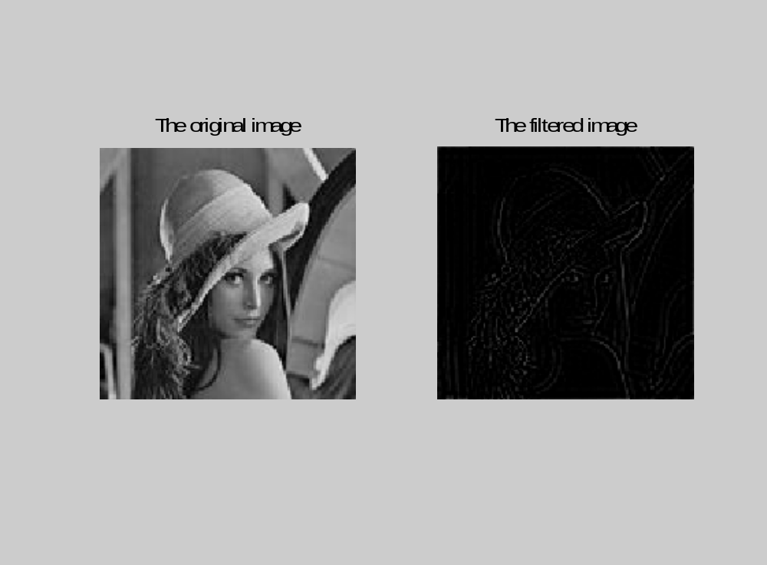
highpass filter

